Slide 1
Anomaly Detection in System Log using Machine Learning
Guided by
Advisor: Dr Premjith B
Dinesh CB.EN.U4AIE19025
Vaishno P CB.EN.U4AIE19048
Asmitha U CB.EN.U4AIE19065
Logesh. V CB.EN.U4AIE19073

Slide 2
Problem Definition
Anomaly detection on log sequences utilizes transformers to extract features from the log sequence and predict anomaly using machine learning models.
Challenge:
Since the dataset is biased it would be difficult for the models to distinguish between normal and anomaly labels.

Slide 3
DATA SET DESCRIPTION
Dataset is collected from GitHub user @Zhujiem for his project.
A collection of system log datasets for log analysis research.
Dataset used in this project is HDFS (Hadoop distributed file system log).
DATASET | NO OF LOGS | SIZE
HDFS | 11,175,629 | 1.47 GB
In order to study the behavior of different models on the dataset, initially a part of the dataset has been taken (2000 number of logs with annotations)
TOTAL | NO OF NORMAL LOGS | NO OF ANOMOLY LOGS
2000 | 1961 | 69

Slide 4
APPROACHES
Method 1:
Features are extracted using self defined preprocess layer with Bert-base-uncased transformer and trained with distilbert-base-uncased Bert model
Result: Due to highly imbalance nature of the dataset, the model cannot classify any anomalies. All the test long sequences are classified as “normal”.
Method 2:
In this approach, Bert - hugging face (small_bert_uncased) is used for feature extraction and an ANN (dense layer/neural networks) is trained with those features.
Result: Model cannot classify any anomalies due to highly imbalanced data

Slide 5
APPROACHES
Method 3:
In this method, feature extracting is done using transformer small_bert_uncased.
Oversampling method such as SMOTE is applied to features to tackle the imbalance problem in the dataset.
Applying those SMOTE features to various ML algorithms such as K-nearest Neighbor (KNN), Quadratic Discriminant Analysis (QDA), Support Vector Machine (SVM), One class SVM, Local Outlier Factor, Isolation Forest, Logistic Regression, Stochastic gradient descent (SGD) , GaussianNB (naive bayes), Decision Tree, and Random Forest.
Result:
Since the imbalance nature of the dataset has been treated with SMOTE, good accuracy is achieved.

Slide 6
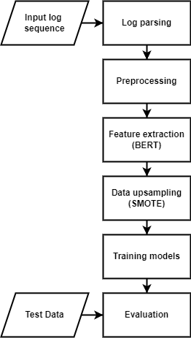
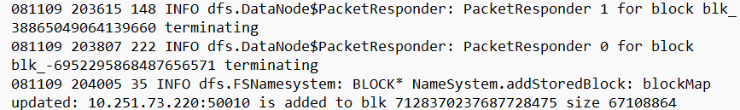
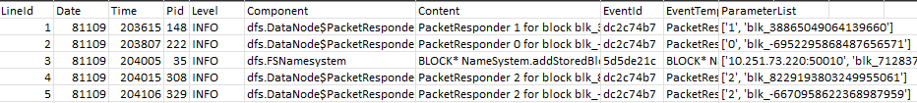
METHODOLOGY
Log parsing is the process of breaking the log lines into smaller chunks and make them structured so that they are easy to interpret and analyse.
These parsed files are stored as CSV files.

Slide 7
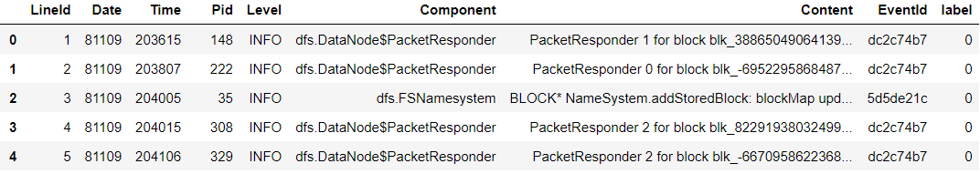
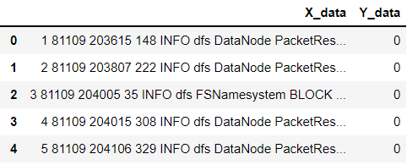
METHODOLOGY
After log parsing, the raw log data is pre-processed using regular expressions which removes all non-alphanumeric characters and punctuation marks.
However, the data is not lower cased as it may lead to misinterpretation of class labels.

Slide 8
METHODOLOGY
BERT provides dense vector representations for natural language by using a deep, pre-trained neural network with the Transformer architecture
The BERT model chosen is Small_bert_uncased
The Small BERT models are the BERT architecture with a smaller number of layers combined with a smaller hidden size. The smaller BERT models are intended for environments with restricted computational resources.
In BERT uncased, the text has been lowercased before tokenization step.
After the Preprocessing step, the log lines are given to Bert model for feature extraction.

Slide 9
METHODOLOGY
Smote(Synthetic Minority Oversampling Technique) is a statistical technique for increasing the number of cases in our dataset in order to make it balanced.
SMOTE takes the entire dataset as an input, but it increases the percentage of only the minority cases.
 | TOTAL | NO OF NORMAL LOGS | NO OF ANOMOLY LOGS
Original Dataset | 2000 | 1961 | 69
After applying SMOTE | 3862 | 1931 | 1931

Slide 10
METHODOLOGY
In this step, SMOTE features has to be given to ML algorithms for training.
ONE CLASS SVM
The aim is to separate data into two classes the positive one considered as the class of normal and the negative one considered as the class of anomaly.
The reason why we used one class SVM is due to their flexibility in fitting complex nonlinear boundaries between normal and anomaly data.
One class SVM learns the boundary for the normal data points and identifies the data outside the border to be anomalies.

Slide 11
Training Models
Some other training models include,
Light Grade Boost Machine - LightGBM is a high performance gradient boosting framework based on decision tree algorithms.
Quadratic Discriminant Analysis – QDA is a generative model, that assumes each class follow a Gaussian distribution and fits a quadratic decision boundary using Bayes’s rule
Local Outlier Factor – LOF is an unsupervised anomaly detection method which computes the local density deviation of a given data point with respect to its neighbors.
Isolation Forest – Its an unsupervised anomaly detection that identifies anomaly by isolating outliers in the data i.e., how far a data point is to the rest of the data.
Stochastic Gradient Descent – SGD is an efficient optimization algorithm used to find the values of parameters of functions that minimize a cost function.

Slide 12
RESULTS
S.No | Model | Accuracy (%) | Training time
1 | Quadratic Discriminant Analysis | 100 | 0.990178
2 | Light Gradient Boost Machine | 99.74 | 13.374086
3 | Random Forest | 99.22 | 7.830748
4 | Gaussian Process | 92.36 | 15.278801
5 | Decision Tree | 91.84 | 3.349145
6 | Linear Support Vector Machine | 86.28 | 1.900675
7 | K-Nearest Neighbour | 83.31 | 0.008269
8 | Stochastic Gradient Descent | 78.39 | 0.418029
9 | Local outlier factor | 67.01 | 0.410968
10 | Neural Net | 65.58 | 4.249635

Slide 13
RESULTS
S.No | Model | Accuracy (%) | Training time
11 | Radial Basis Function(RBF) SVM | 57.30 | 2.658658
12 | Poly SVM | 57.05 | 2.391074
13 | Naive Bayes | 56.01 | 0.035898
14 | RBF OneClassSVM | 55.62 | 1.981425
15 | Isolation Forest | 53.55 | 0.676061
16 | Sigmoid OneClassSVM | 51.09 | 2.037405
17 | Linear OneClassSVM | 50.97 | 1.817755
18 | Linear OneClassSVM - SGD | 50.84 | 0.034339
19 | Poly OneClassSVM | 50.71 | 1.868596
20 | Sigmoid SVM | 48.64 | 2.858593

Slide 14

Tentative Timeline
15-08-2022 –
30-08-2022
16-09-2022 –
10-10-2022
21-10-2022 –
30-10-2022
Designing the problem statement
Pre-Processing & Encoding
Training the Model
Improvements Based on results
Final Result
01-09-2022 –
15-09-2022
11-10-2022 –
20-10-2022

Slide 15
IMPROVEMENTS
For feature extraction, Small_bert_uncased takes lot of time to process. In order to reduce the time taken, distilbert_en_cased or logbert can be used.
The next step of improvement is to use distilbert_en_cased or logbert that can reduce time taken for feature extraction.
To train the models for the whole dataset and to provide comparative results between different ML algorithms .

